Slide 1

SPEAC

Slide 2
The key aims and objectives against which we feel our project should be judged

Slide 3
Main objectives
Build an application that provides charts and reports in the SPE MS Teams group and ultimately provides up-to-date insight into the progress of the SPE groups
Allow users to interact with Microsoft Teams via Microsoft Graph API
Analyse, visualize and demonstrate GitHub metrics
Combine the functionality of CMS and GHAM (Utilize database from CMS and library from GHAM)

Slide 4
The degree to which our project achieves our aims and objectives

Slide 5
Aims and objectives achieved
Successfully utilized Microsoft Graph API to integrate with Microsoft Teams with a command line application
Successfully built and deployed a website on a long-running server
Successfully linked with CMS database
Successfully imported GHAM Java library
Successfully analyzed and visualized metrics with charts (combine and select metrics and choose appropriate charts for visualization)

Slide 6
Technology Stack
HTML, CSS, JavaScript, Java, VueJS, ElementUI, Apache Echarts, Spring
Services Utilized
AWS amplify/EC2/Elastic Beanstalk, Microsoft Azure
Application Interacted
MS Teams, GitHub

Slide 7
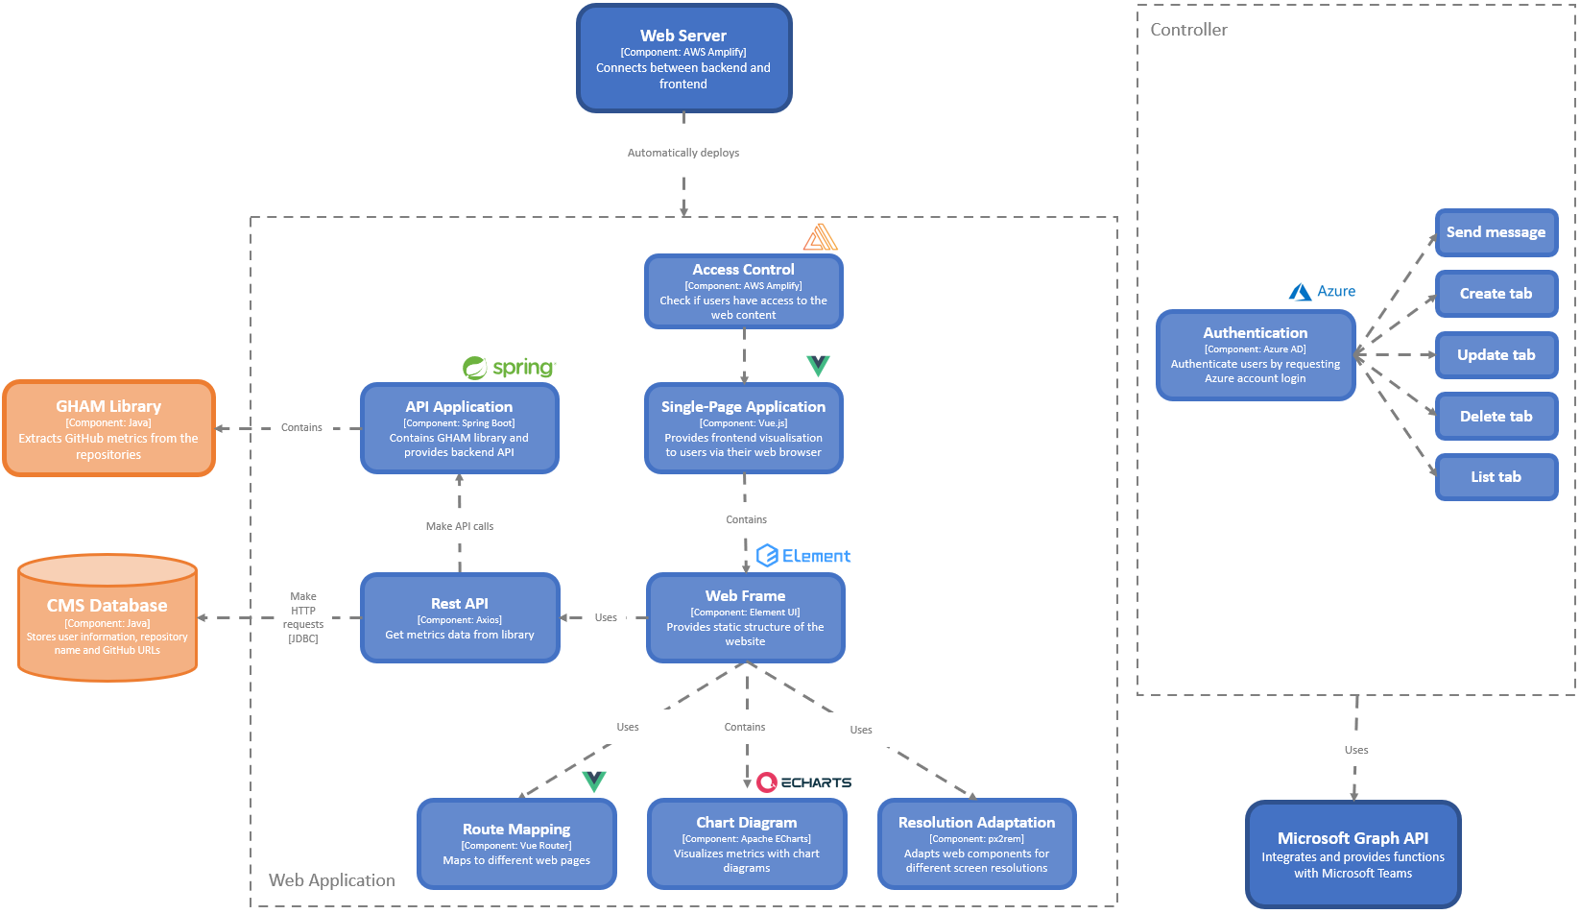

Slide 8
Strategies and mechanisms put in place to ensure that our development process was
mature and repeatable

Slide 9
Strategies and mechanisms
Collaboration
Using Github for version control
Using Kanban board for task distributing
Using Teams to communicate within our group
Using Teams to collaborate with other groups
Using Google Docs to make portfolio
Using Email and video chats to speak with clients
Agile Software Development
Deployed CircleCI and manual testing for testing across the whole development process
Get feedback from group members and sometimes client for version updates

Slide 10
Key challenges and problems that our team encountered

Slide 11
Technological Challenges
The whole development process should be within two weeks - limited time frame
We are new to MS Graph API
Very little documentation and not much support for some functionalities
Most members are not familiar with web development
Take time to determine the full stack architecture
Need to learn new techniques in short time
The integration with CircleCI

Slide 12
Group Work Challenges
Client Facing Challenges
Different time zones and locations
Communication with other two groups wasn’t efficient in the beginning and misunderstanding was made
Groups had different development progress - we tried our best to fulfill our functionality without influence of other groups
Client didn’t have much experience with Graph API - limited support
Client let us much space in choosing the ways of presenting the final result - free research needed (We collected and compared some existing solutions online)

